Slide 1

Module 1: Mean Value Theorems
Department of Mathematics Jain Global campus, Jakkasandra Post, Kanakapura Taluk, Ramanagara District -562112
Prof. VEERESH MALAGI
Department of Mathematics,
FET, Jain(Deemed-to-be-University)

Slide 2
CONTENTS
Mean Value Theorems
Lagrange's Mean Value theorem
Geometrical Interpretation
Problems

Slide 3
Lagrange’s Mean Value Theorem

Slide 4
Lagrange’s Mean value Theorem

Slide 5
Proof:

Slide 6
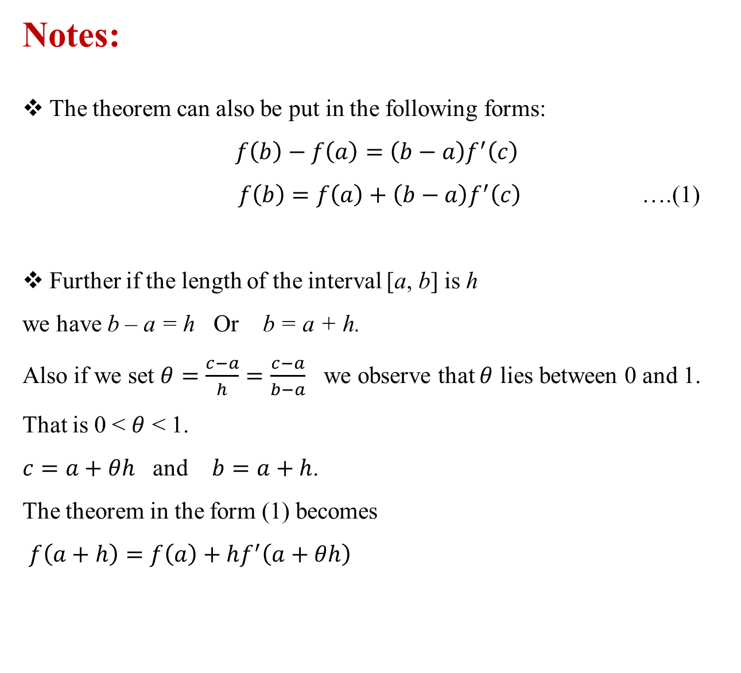
Notes:
The theorem can also be put in the following forms:
$$f\left(b\right)−f\left(a\right)=\left(b−a\right)f^{′}\left(c\right)$$
$f\left(b\right)=f\left(a\right)+\left(b−a\right)f^{′}\left(c\right)$ ….(1)
Further if the length of the interval [a, b] is h
we have b – a = h Or b = a + h.
Also if we set $θ=\frac{c−a}{h}=\frac{c−a}{b−a}$ we observe that $θ$ lies between 0 and 1. That is 0 <$θ$< 1.
$c=a+θh$ and $b=a+h$.
The theorem in the form (1) becomes
$f\left(a+h\right)=f\left(a\right)+hf^{′}\left(a+θh\right)$

Slide 7
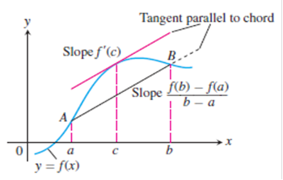
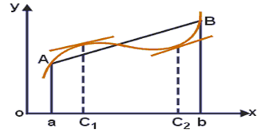
Geometrical Interpretation
There are no breaks or gaps in between a and b for the given curve and including at the end points, hence the given function is continuous in [a, b] .
Since a unique tangent can be drawn at each and every point in the interval except at the end points, the function is differentiable in the (a, b) .
Conclusion: Therefore there exits at least one point ‘c’ (say) in between a and b at which the tangent at ‘c’ is parallel to the chord AB.

Slide 8

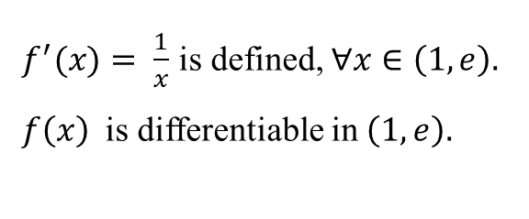


Problems on Lagrange's Mean Value theorem:
1. Verify Lagrange’s Mean Value Theorem for the function in [1, e]
Solution:
$f\left(x\right)$is continuous in [1, e].
$f^{′}(x)= \frac{1}{x}$is defined, $∀x∈\left(1,e\right).$
$f\left(x\right)$ is differentiable in $\left(1,e\right).$
$$⇒$$
$$⇒$$
All conditions of Lagrange’s Mean Value Theorem are satisfied,
therefore there exist one point ‘c’ such that
Hence Lagrange’s Mean Value Theorem is verified.

Slide 9


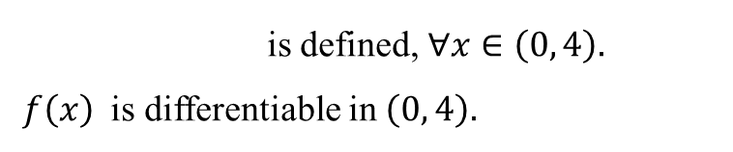
2. Verify Lagrange’s Mean Value Theorem for the function in [0, 4]
Solution:
f(x) is continuous function as it is an algebraic function in [0, 4]
is defined, $∀x∈\left(0, 4\right).$
$f\left(x\right)$ is differentiable in $\left(0, 4\right).$
$$⇒$$
All conditions of Lagrange’s Mean Value Theorem are satisfied,
therefore there exist one point ‘c’ such that
and 0.85 both $∈\left(0, 4\right).$

Slide 10
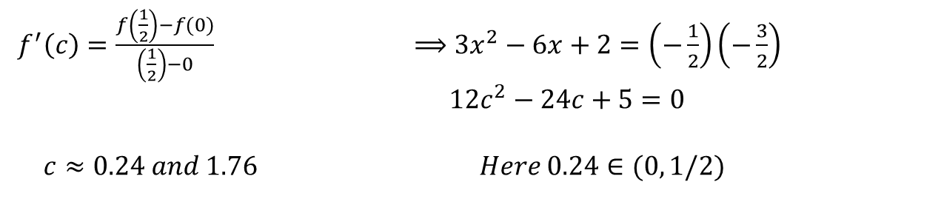

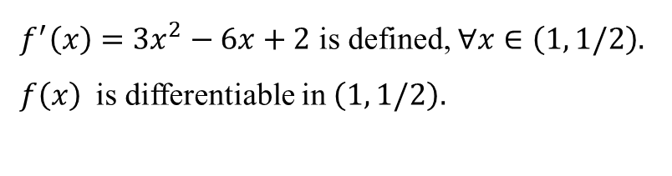


Verify Lagrange’s Mean Value Theorem for the function $f\left(x\right)=x(x−1)(x−2)$
in [0, 1/2]
Solution:
$f\left(x\right)$is continuous in [1, 1/2].
$$⇒$$
$f^{′}\left(x\right)=3x^{2}−6x+2$is defined, $∀x∈\left(1, 1/2\right).$
$f\left(x\right)$ is differentiable in $\left(1, 1/2\right).$
$$⇒$$
All conditions of Lagrange’s Mean Value Theorem are satisfied,
therefore there exist one point ‘c’ such that
$f^{′}\left(c\right)=\frac{f\left(\frac{1}{2}\right)−f(0)}{\left(\frac{1}{2}\right)−0}$$⟹$$3x^{2}−6x+2=\left(−\frac{1}{2}\right)\left(−\frac{3}{2}\right)$
$12c^{2}−24c+5=0$
$$c≈0.24 and 1.76 Here 0.24∈(0, 1/2)$$
Hence Lagrange’s Mean Value Theorem is verified.

Slide 11

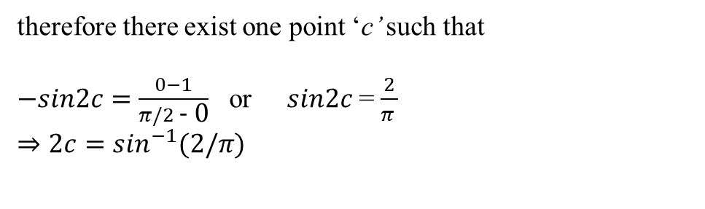


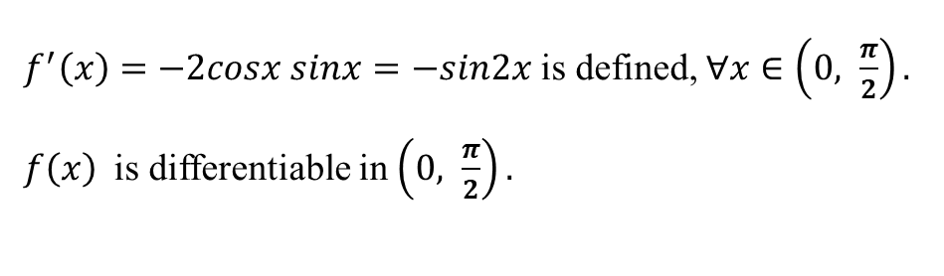
4. Verify Lagrange’s Mean Value Theorem for the function $f\left(x\right)=$$\cos^{2}x$ in [0, $\frac{π}{2}$]
Solution:
$f\left(x\right)$is continuous in [$0, \frac{π}{2}$].
$f^{′}\left(x\right)=−2cosx sinx=−sin2x$ is defined, $∀x∈\left(0, \frac{π}{2}\right).$
$f\left(x\right)$ is differentiable in $\left(0, \frac{π}{2}\right).$
$$⇒$$
$$⇒$$
All conditions of Lagrange’s Mean Value Theorem are satisfied,
therefore there exist one point ‘c’ such that
$−sin2c=\frac{0−1}{π/2\text{ − }\text{0}}$ or $sin2c$ = $\frac{2}{π }$
$⇒$$2c=\sin^{−1}(2/π)$
Therefore c = 0.345 $∈ (0, \frac{π}{2})$
Hence Lagrange’s Mean Value Theorem is verified.

Slide 12

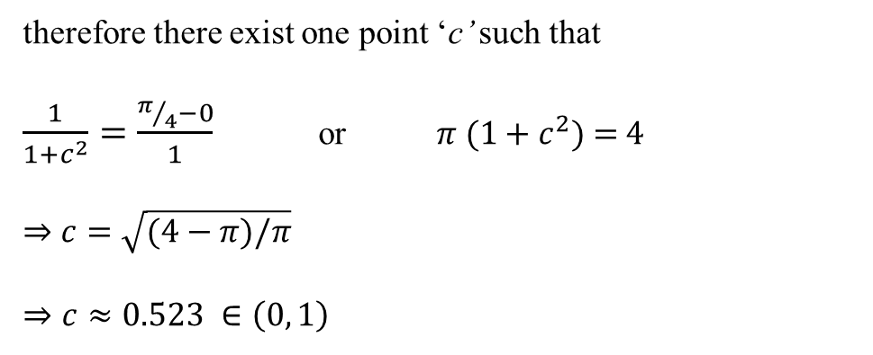


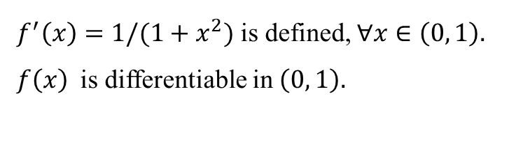
5. Verify Lagrange’s Mean Value Theorem for the function $f\left(x\right)=$$\tan^{−1}x$ in [0, 1]
Solution:
$f\left(x\right)$is continuous in [$0, 1$].
$$⇒$$
$f^{′}\left(x\right)=1/(1+x^{2})$ is defined, $∀x∈\left(0, 1\right).$
$f\left(x\right)$ is differentiable in $\left(0, 1\right).$
$$⇒$$
All conditions of Lagrange’s Mean Value Theorem are satisfied,
therefore there exist one point ‘c’ such that
$\frac{1}{1+c^{2}}=\frac{π/4−0}{1}$ or $π (1+c^{2})$ = 4
$⇒$$c=\sqrt{(4−π)/π}$
$⇒c≈0.523 ∈\left(0, 1\right)$
Hence Lagrange’s Mean Value Theorem is verified.

Slide 13


6.
Solution:
Applying Lagrange's mean value theorem for this f(x) in [0, x], we have,
but
$$∴f\left(x\right)=xf^{′}\left(c\right);$$
$$f^{′}\left(x\right)>0⇒f^{′}\left(c\right)>0$$
and hence
or

Slide 14
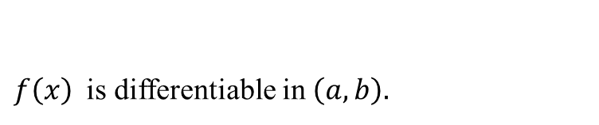
7. Prove that where using Lagrange’s
mean value theorem
Solution:
, f (x) is continuous in [a, b] and
$f\left(x\right)$ is differentiable in $\left(a, b\right).$
$$⇒$$
Applying Lagrange’s mean value theorem , for $f\left(x\right)$ in [ a, b]
We know that a < c < b
on multiplying by (b - a) which is positive, we have

Slide 15
8.

Slide 16
ii.

Slide 17
THANK YOU

